Slide 1
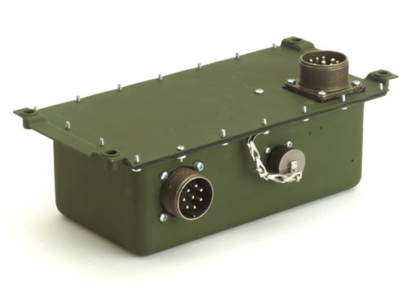

Presentation to
TACOM / AM General
Smart Start System
7 September 2006

Slide 2
Enhancements
S3 Enhancements over the EESS
A backwards compatible design with improvements for known field issues:
  Elimination of pulsing headlamps and voltmeter gauges.
  Immunity to glow plug re-activation when horn is used.
  Provides for lower current starter switch as well as starter lockout while engine is running.
  Does not flash the wait-to-start lamp during default mode operation to avoid operator confusion.
  Operates with same temperature sensor as used for the EESS.
  Immunity to relay icing.
  Improved glow plug tip temperature control.
  Vehicle ground fault tolerant.
  Newly developed sealing system to meet stricter requirements.
  Meets more severe EMI requirements.
  Over current protection added for the wait-to-start and brake warning lamp circuits.

Slide 3
Enhancements Cont’d
  Withstands ESD for packaging and handling classification test of SAE J1113-13 to +25kV.
  Uses chemical agent resistant coating (CARC).
  Diagnostics through SAE J1939 compliant data bus.
  Compatible with other SAE J1939 components.
  Monitors and records unit parameters as an additional aid for system troubleshooting.
  Electrical serialization providing for lot traceability.
  Field reprogrammable to meet future enhancements and upgrades utilizing existing equipment.
  Field useable application for Maintenance Support Device (MSD) is available for the S3 and vehicle diagnostics.

Slide 4
Diagnostics
S3 Diagnostic Capabilities
The S3 has the capability to monitor the following fault conditions and report them over a J1939 CAN bus:
  System voltage too high for operation.
  System voltage too low for operation.
  Glow plugs not connected / open.
  Glow plugs shorted.
  Glow plug driver failure.
  Temperature probe fault high or low.
  Glow Plug Controller used in place of Temperature Probe.
  Wait-to-start lamp over current.
  Brake lamp over current.
  Relay fault.
  Gate voltage too low.

Slide 5
Diagnostics
S3 Diagnostics Continued
The following status indicators have been added to the S3 design:
  R-tap signal presence on/off.
  Wait-to-start lamp on/off.
  Starter engaged/not engaged.
  Current temperature range.
  Brake lamp on/off.

